Slide 1

INTERIM
REPORT
GROUP 5

Slide 2

TABLE OF CONTENTS
TOPIC | PAGE NUMBER
Project Summary | 3
Introduction | 4
Problem Statement | 5
Goal of Project | 5
EDA | 6
Data Preview | 6
Shape of data | 6
Data Information | 6-7
Columns in the Dataset | 7
Data Description | 7
Inferences | 8-9
Null Values | 9
Inferences | 9
Null value Treatment | 9-10
Data Description after null values | 10
Inferences | 10-11
Univariate Analysis | 11-13
Inferences | 13-14
Bivariate Analysis | 14-16
Inferences | 16-17
Notes for project team | 18

Slide 3
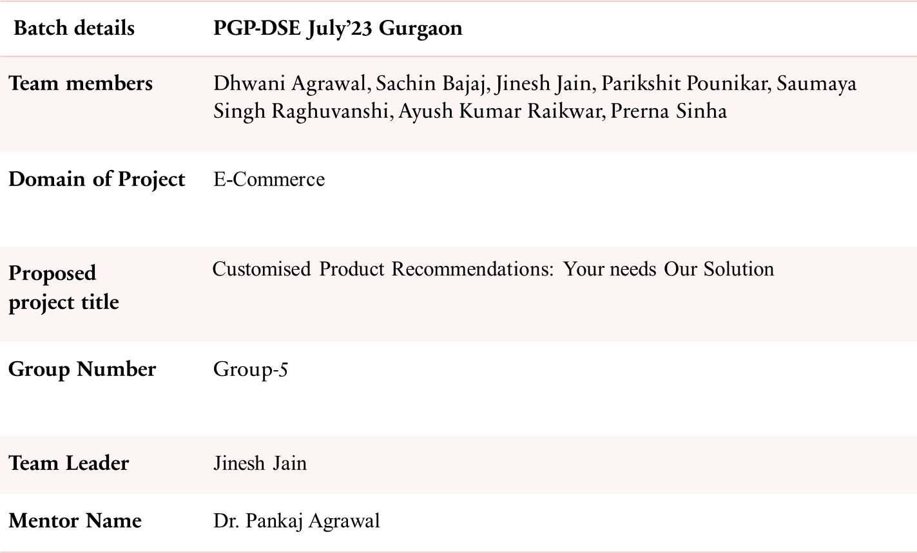
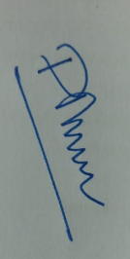
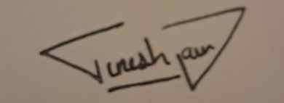
PROJECT SUMMARY
Customised Product Recommendations
3
Date: 15th March 2024
Signature of the Mentor
Signature of the Team Leader

Slide 4
1. INTRODUCTION
Customised Product Recommendations
4
Customers are frequently overpowered by the sheer number of things accessible in the wide world of e-commerce, where choice is king. Decision fatigue, postponed purchases, and even unhappiness with the chosen option might result from this paradox of choice. Product recommendation systems have become a potent tool to help buyers find products that suit their unique needs and preferences in response to this difficulty.
One of the biggest online retailers in the nation, Amazon India, has an enormous selection of goods in many different categories. But for consumers, knowing how to navigate this large catalogue successfully might be intimidating. When it comes to providing a genuinely customised and user-friendly buying experience, traditional search and filtering methods frequently need to be revised.
This is where chatbot technology's potential shows itself, providing a more dynamic and conversational method of product discovery.

Slide 5
2. PROBLEM STATEMENT
Customised Product Recommendations
5
Web-scraping an e-commerce website (Amazon India) to create a dataset where the product's details are checked and then a chatbot is coded to provide the solutions based on user input, e.g., the user asks to recommend a phone under 40k. Following are the parameters based on which recommendation will be provided:
Recommendation based on Price
Recommendation based on Brand
Recommendation based on Memory
Recommendation based on Rating
3. GOAL OF THE PROJECT
The goal of this project is to create a chatbot that uses web-scraped data from Amazon India to close the gap between the amount of product information and the demand for individualised recommendations. Price, brand, memory, and rating are the four main product factors that are most important in influencing decisions to buy. The chatbot aims to improve customer happiness by streamlining the purchasing experience by allowing consumers to filter recommendations based on these parameters.Project involves comprehensive data preprocessing, exploratory data analysis, and feature engineering to enhance the accuracy of the predictive model

Slide 6
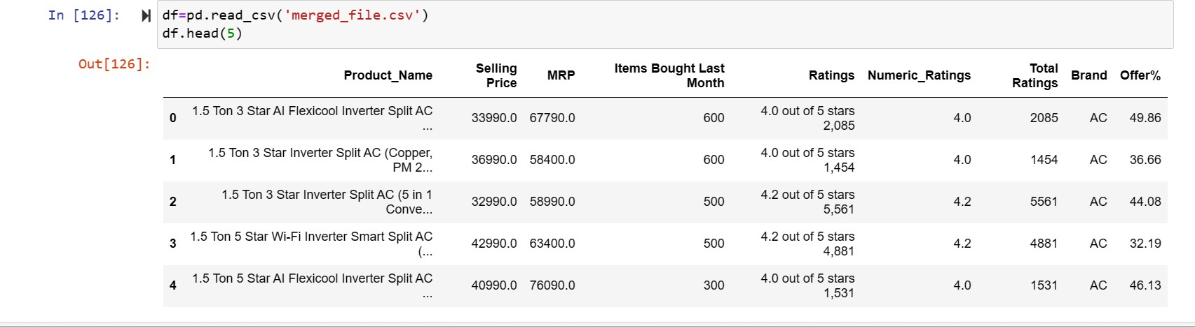
4. EXPLORATORY DATA ANALYSIS
Customised Product Recommendations
6
DATA PREVIEW
SHAPE OF DATA
DATA INFORMATION

Slide 7
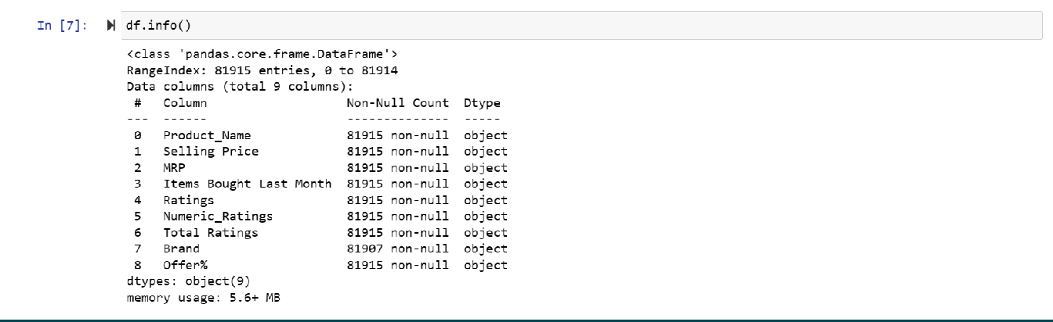
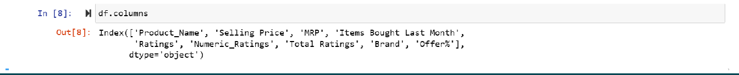
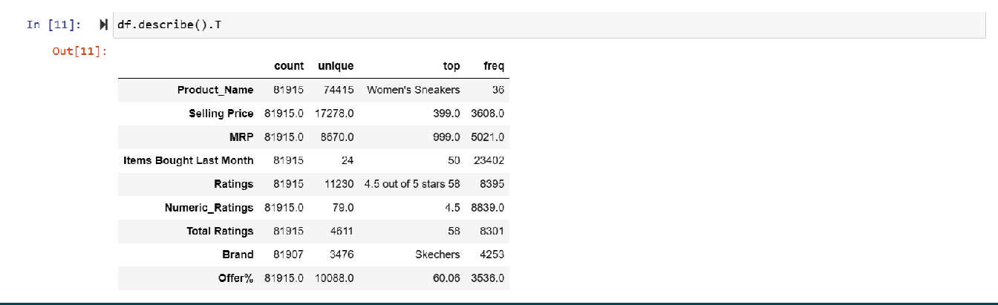
Customised Product Recommendations
7
COLUMNS IN THE DATASET
DATA DESCRIPTION

Slide 8
Customised Product Recommendations
8
INFERENCES
1. | Price Analysis:
 |  | The Selling Price ranges from 399.0 to 81915.0, indicating a wide range of pricing options. The MRP (Maximum Retail Price) also varies significantly from 999.0 to 81915.0. The Offer% ranges from 0% to 100.06%, suggesting there are various discounts offered on different occasions or for different products within the same category.
2. | Sales Performance:
 |  | The number of items bought last month varies, with a maximum of 23402 units sold, suggesting a high demand for this product. The high number of units sold indicates a strong market demand for women's sneakers. This could be influenced by factors such as brand reputation, style, quality, and marketing efforts.
3. | Customer Satisfaction:
 |  | The average numeric rating is 4.5 out of 5 stars, based on 8839 ratings. This indicates a high level of customer satisfaction with the product. Positive ratings can contribute to brand loyalty and repeat purchases.
4. | Brand Analysis:
 |  | Skechers appears to be the dominant brand in this category, with 4253 mentions out of 81907 records. Skechers seems to have a strong presence and customer preference in the women's sneaker market. The brand's reputation might influence purchasing decisions and contribute to its market share.
5. | Price vs. Demand:
 |  | There seems to be an inverse relationship between price and the number of items bought, with higher-priced items selling fewer units. The presence of discounts (Offer%) might influence consumer behavior, leading to increased sales for discounted items.
6. | Price vs. Ratings:
 |  | Higher-priced items may have higher ratings, suggesting that customers perceive them as higher quality or value for money. However, this relationship would need further analysis to determine causality accurately.

Slide 9
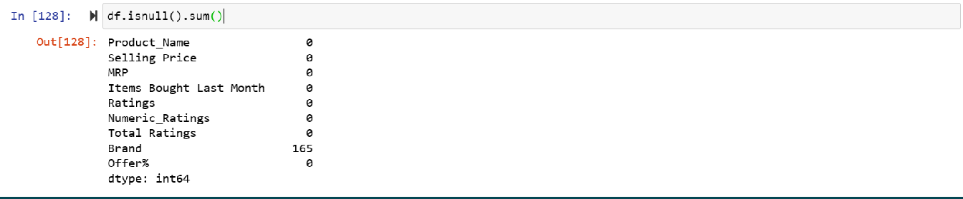
Customised Product Recommendations
9
In conclusion, "Women's Sneakers" seem to be a popular product, especially those offered by the Skechers brand, with varying price points and discounts influencing consumer behavior. The high sales volume and positive ratings indicate a strong market position for this product.
NULL VALUES
INFERENCES
The completeness of data for most columns suggests that thorough analysis can be conducted regarding pricing, sales performance, brand popularity, and customer satisfaction.
The presence of missing values in the "Brand" column may require further investigation or handling, such as imputation or exclusion, depending on the analysis goals.
Overall, the dataset seems suitable for various analyses related to product performance, pricing strategies, and customer preferences. However, consideration should be given to handling missing brand information appropriately.
NULL VALUE TREATMENT

Slide 10
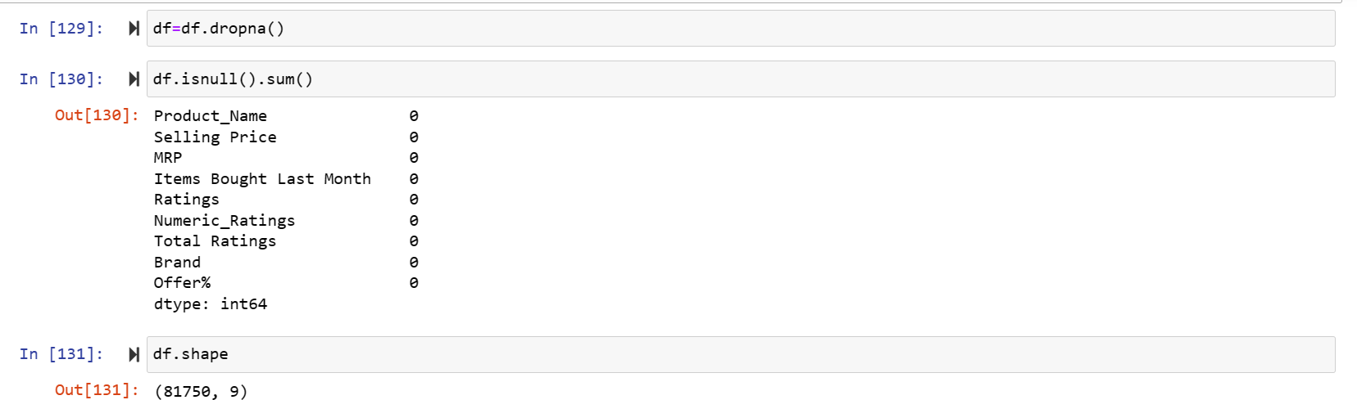
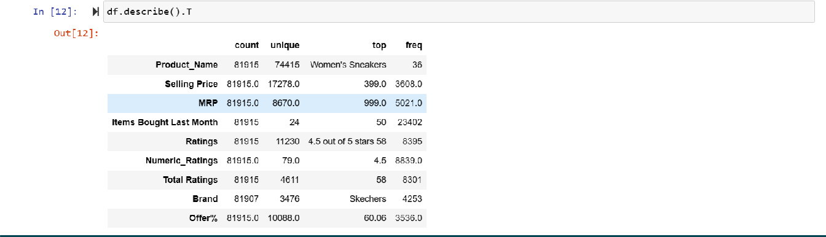
Customised Product Recommendations
10
DATA DESCRIPTION AFTER NULL VALUE TREATMENT
INFERENCES
The provided data suggests that "Women's Sneakers" is a popular product, particularly the variant with 23402 units sold last month, possibly due to its pricing, features, or marketing.
Skechers, being the associated brand, likely contributes to the product's popularity and sales performance.
Customer ratings and feedback are generally positive, indicating good product quality and customer satisfaction.
Variation in pricing and offer percentages suggests dynamic pricing strategies aimed at maximizing sales and revenue.

Slide 11
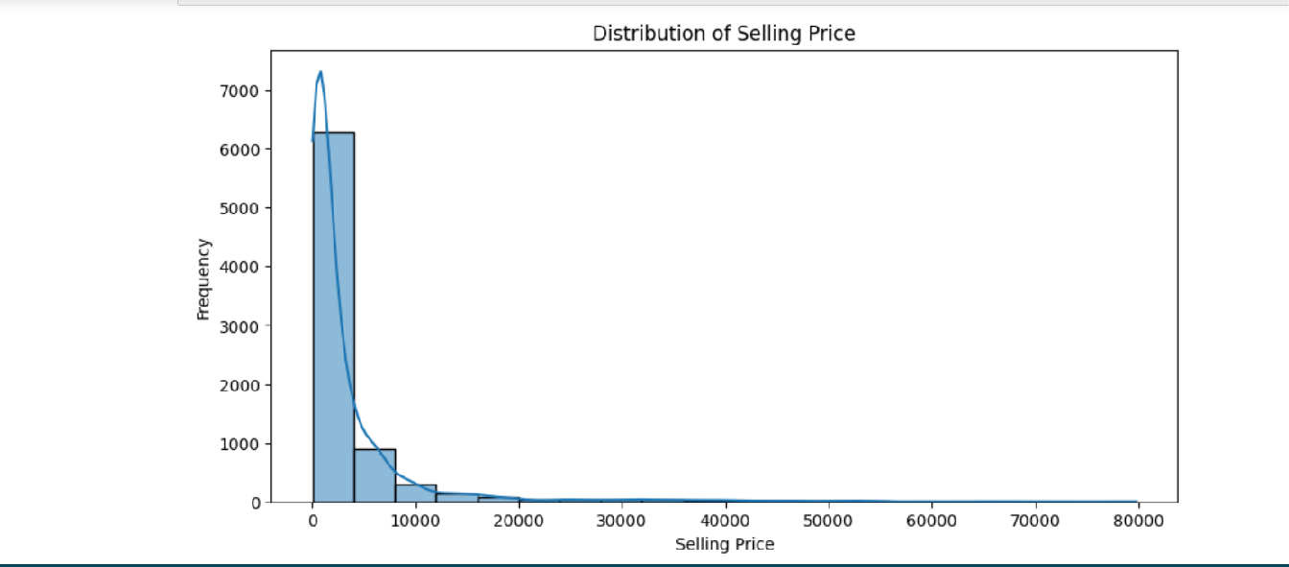
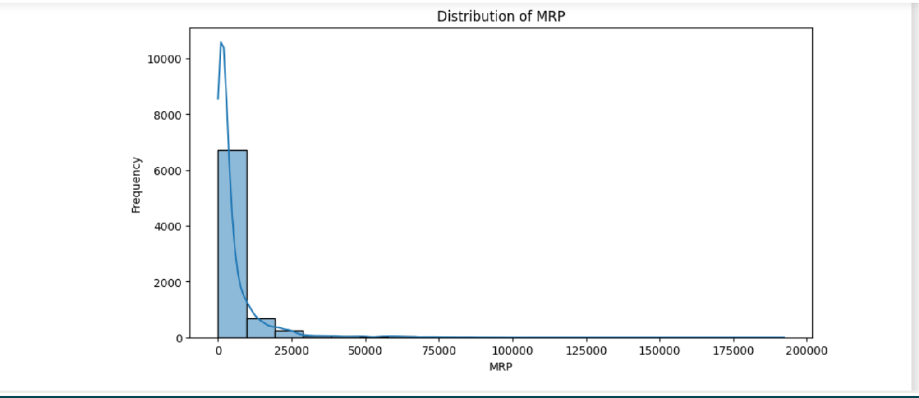
Customised Product Recommendations
11
Overall, the data provides insights into the sales performance, customer feedback, and brand presence of "Women's Sneakers," indicating a successful product line with strong market demand.
UNIVARIATE ANALYSIS

Slide 12
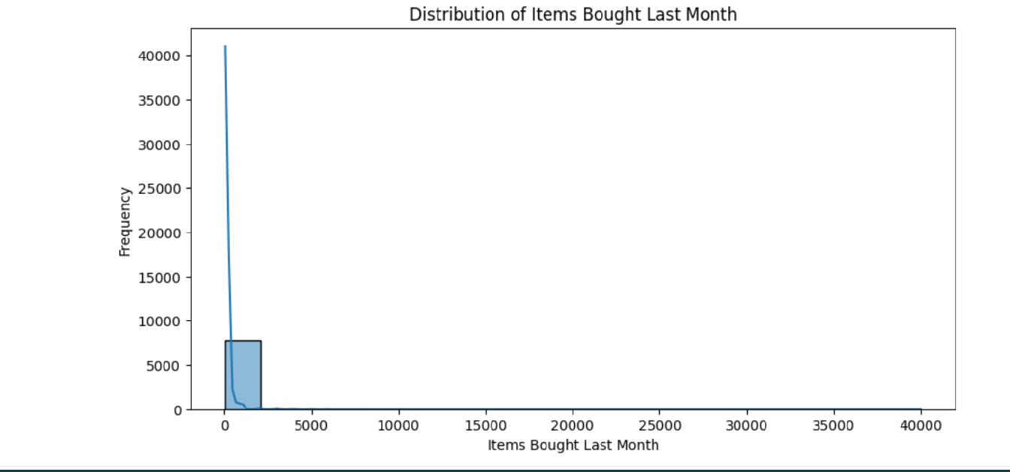
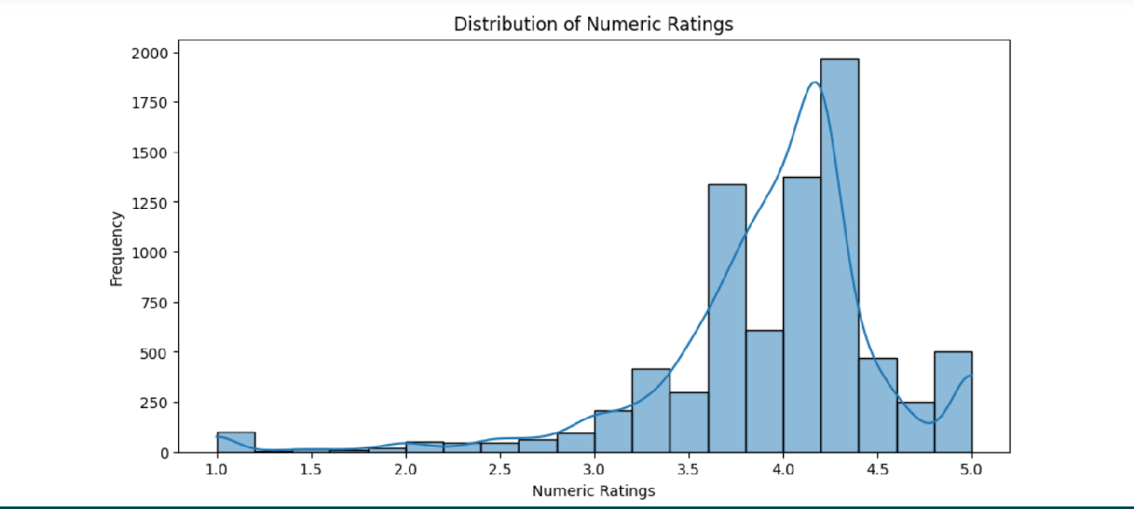
Customised Product Recommendations
12

Slide 13
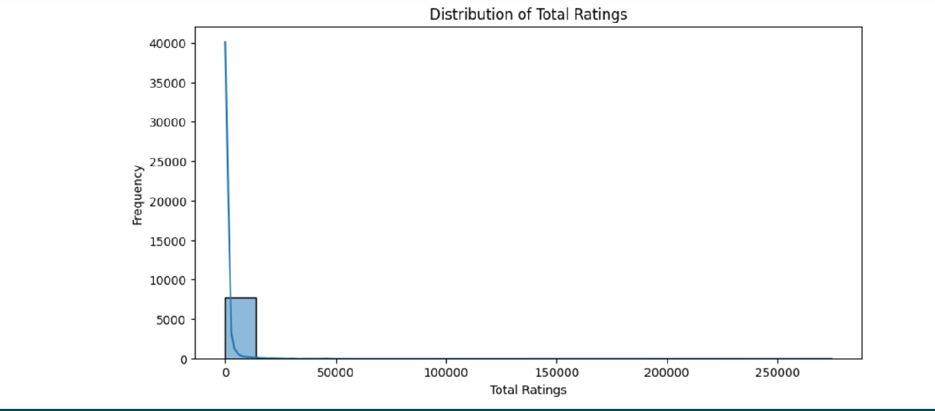
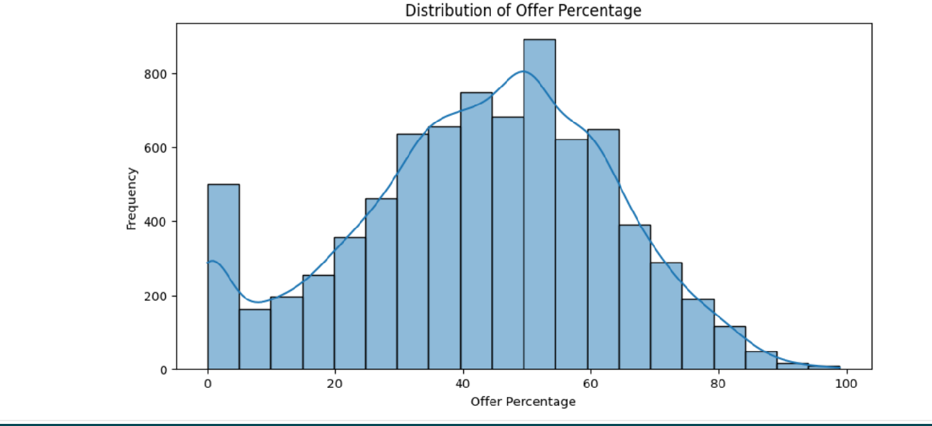
Customised Product Recommendations
13
INFERENCES
Selling Price: The distribution of selling prices is diverse, with a concentration around lower values. There are products with a broad range of selling prices, including some high-priced items.
MRP: The distribution of Maximum Retail Prices (MRP) is right-skewed. Most products have MRPs in the lower to mid-range, with a few products having higher MRPs.
Items Bought Last Month: The distribution of items bought last month indicates variability in product popularity. Some products have lower demand (50 items), while others have higher demand (300 to 40,000 items).
Numeric Ratings: The distribution of numeric ratings is right-skewed, with a concentration around
4.0. Most products have positive ratings, but there are a few with lower ratings.

Slide 14
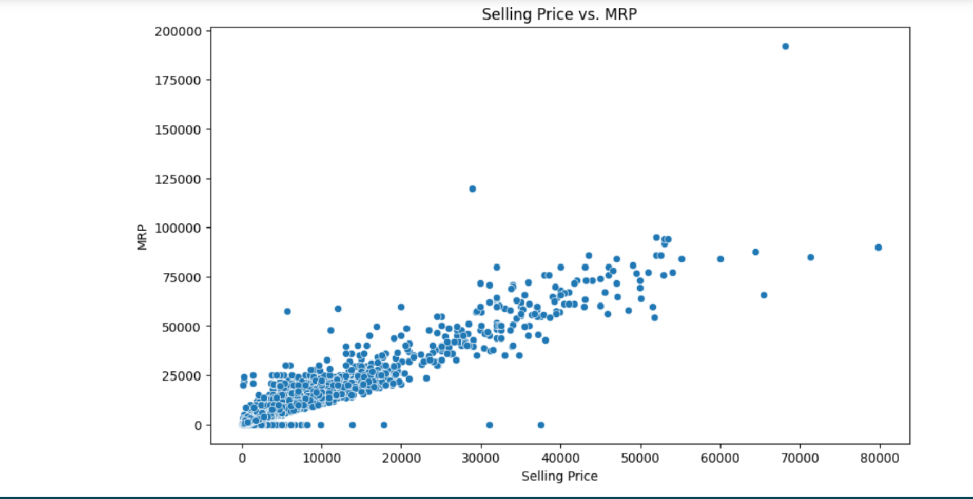
Customised Product Recommendations
14
Total Ratings: The distribution of total ratings is right-skewed, with a few products receiving a significantly higher number of ratings. Most products have a moderate number of total ratings.
Offer Percentage: The distribution of offer percentages is right-skewed. Many products have relatively high offer percentages, indicating the presence of discounts.
General Inferences: The dataset includes a mix of products with varied selling prices, MRPs, and popularity. Numeric ratings are generally positive, indicating overall customer satisfaction. Total ratings suggest that most products have a moderate number of ratings, but some products have attracted a large number of reviews. Offer percentages vary, with some products having notable discounts.
BIVARIATE ANALYSIS

Slide 15
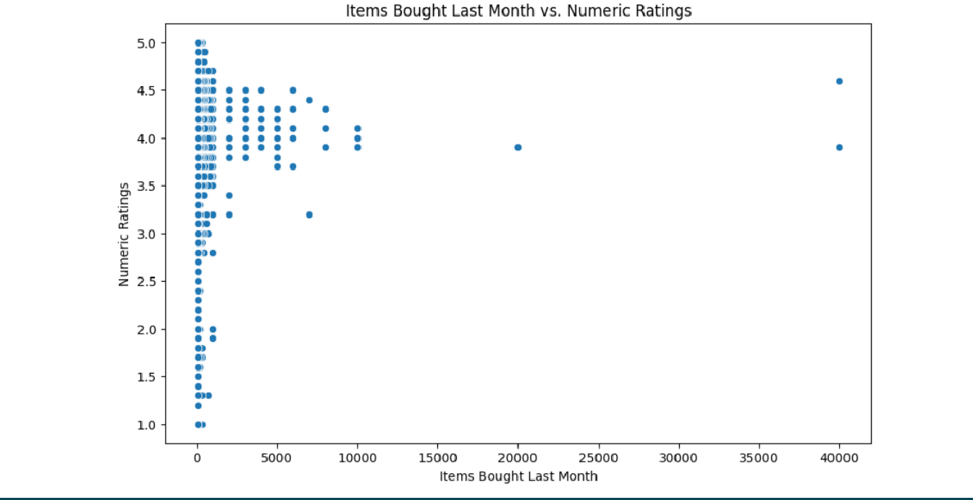
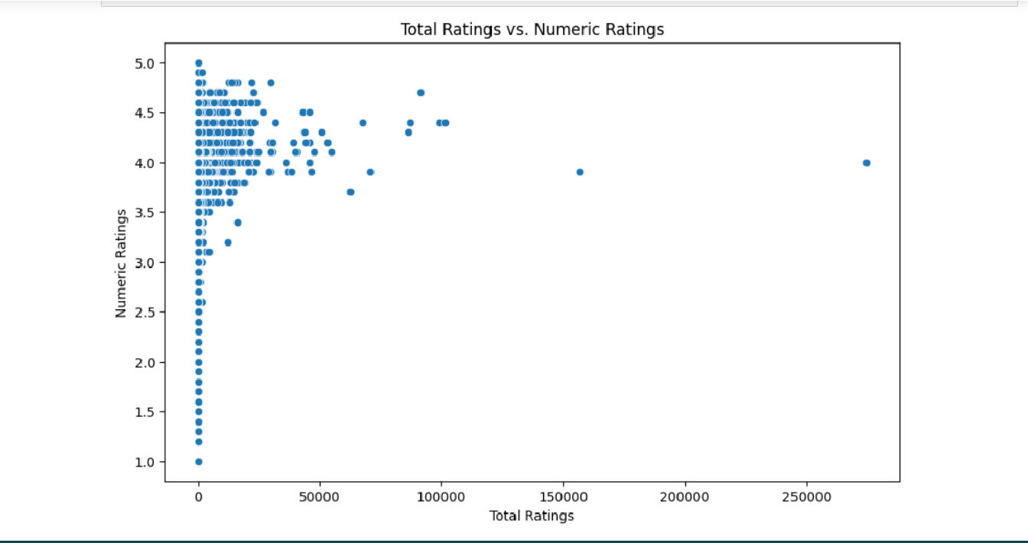
Customised Product Recommendations
15

Slide 16
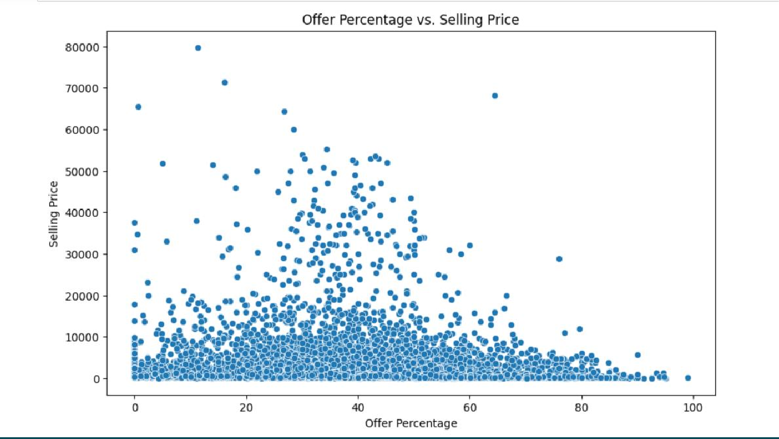
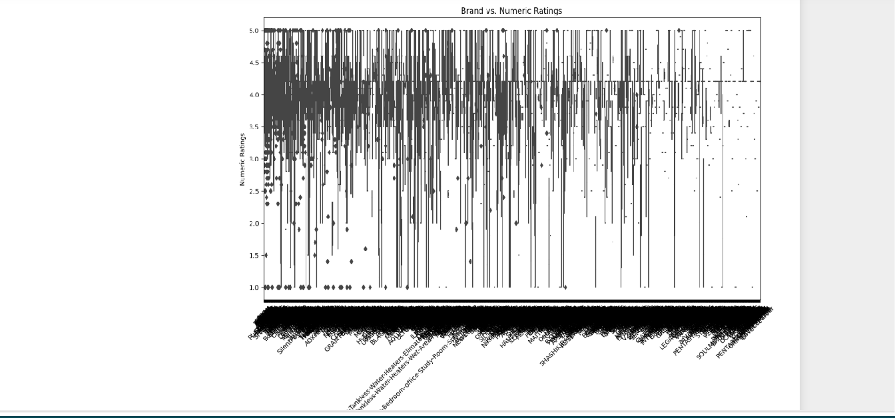
Customised Product Recommendations
16
INFERENCES

Slide 17
Customised Product Recommendations
17
Selling Price vs. MRP: Selling prices and MRPs show a strong positive linear relationship. The increase in selling price corresponds to a proportional increase in MRP, indicating consistent pricing strategies.
Items Bought Last Month vs. Numeric Ratings: There is no clear linear relationship between the number of items bought last month and numeric ratings. The popularity of a product, as measured by items bought, does not necessarily correlate strongly with higher ratings.
Total Ratings vs. Numeric Ratings: There is a positive linear relationship between total ratings and numeric ratings. Products with higher total ratings tend to have higher numeric ratings, suggesting that well-received products attract more ratings.
Offer Percentage vs. Selling Price: There is no clear linear relationship between offer percentage and selling price. Higher-priced products do not consistently have higher or lower offer percentages.
Offer Percentage vs. Numeric Ratings: There is no clear linear relationship between offer percentage and numeric ratings. The presence of discounts (offer percentage) does not strongly correlate with higher or lower numeric ratings.
Brand vs. Numeric Ratings: Different brands have varying distributions of numeric ratings. Some brands have a higher median rating, indicating better overall customer satisfaction, while others have a wider range of ratings.
General Inferences: The strong positive correlation between selling price and MRP suggests consistent pricing strategies across products. Popularity, as measured by the number of items bought last month, does not strongly correlate with higher numeric ratings. Higher total ratings tend to be associated with higher numeric ratings, indicating a positive relationship between overall popularity and customer satisfaction. The presence of discounts (offer percentage) does not consistently correlate with higher or lower ratings. Brands play a role in determining customer satisfaction, with some brands consistently receiving better ratings than others.

Slide 18
Customised Product Recommendations
18
NOTES FOR PROJECT TEAM
Original owner of data | Amazon
Data set information | Web scraped from amazon website.
Previous relevant journals used the data set | It is a fresh dataset as we have web scraped it and then form a dataset
Citation | -
Link to web page | -

